Slide 1
CS488 Final Report
11.29.19
Cyrus baker, Lucas Herrmann, Ivan nieto

Slide 2
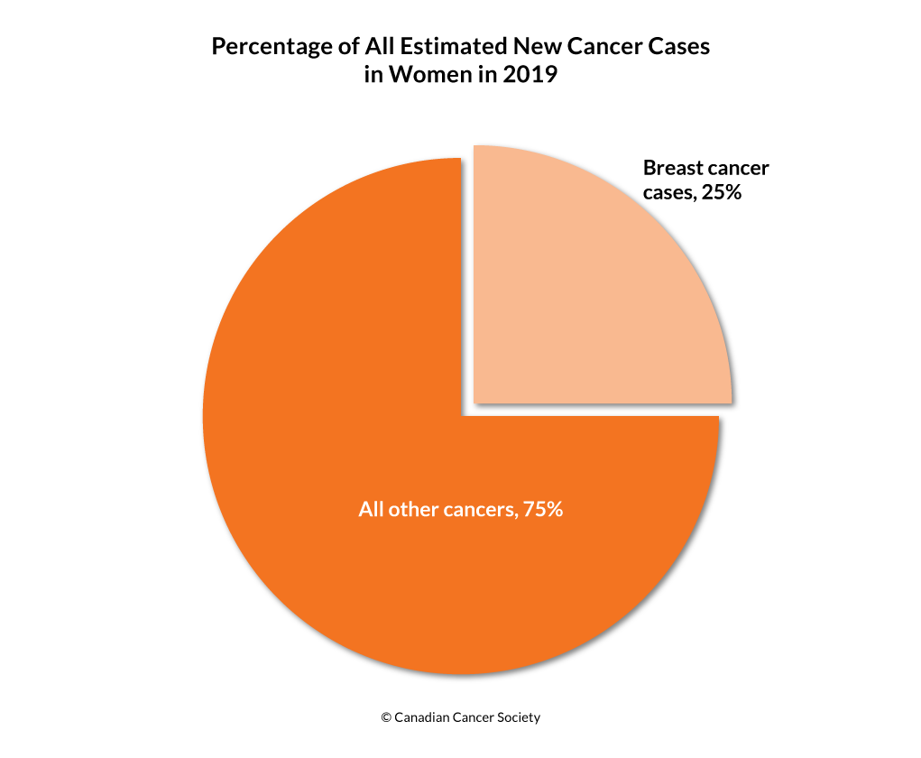
The Problem
About 1 in 8 U.S. women will develop breast cancer.
About 41,760 women in the U.S. are expected to die in 2019 from breast cancer.
Malignant tumors are considered cancerous and can lead to death.
Benign tumors are not considered dangerous to health.
Notes:
Malignant tumors are aggressive because they invade and damage surrounding tissue.
Benign tumors are harmless, doctors will usually leave it alone rather than remove it

Slide 3
Data
Breast Cancer data from University of Wisconsin
9 Attributes
Jan 1989 – Nov 1991
Sample Code # 699 non-null int64
Clump Thickness 699 non-null int64
Uniformity of Cell Size 699 non-null int64
Uniformity of Cell Shape 699 non-null int64
Marginal Adhesion 699 non-null int64
Single Epithelial Cell Size 699 non-null int64
Bare Nuclei 699 non-null object
Bland Chromatin 699 non-null int64
Normal Nucleoli 699 non-null int64
Mitoses 699 non-null int64
Class - 2=Benign 4=Malignant 699 non-null int64
Notes:
The data was collected in groups and group 1 was edited by the University of Wisconsin to remove entries with missing values.
9 Attributes excluding ID and Class

Slide 4
Pre-processing of Data
Removed Null values
16 values in Bare Nuclei column removed
Detected and removed outlier values
Notes:
The data was collected in groups and group 1 was edited by the University of Wisconsin to remove entries with missing values.
9 Attributes excluding ID and Class

Slide 5
Outlier Detection and Removal
Methods used:
Z-Score (Signed Standard Deviations)
IQR (Interquartile Range)
IQR generally slightly higher scores by ~3-5%
Major decrease in classifiers accuracy
Isolated into separate .py file

Slide 6
Outlier Removal
Using Z score
Decision tree Entropy (94.89%)
Decision tree Gini (93.59%)
K-Nearest Neighbor Manhattan (96.53%)
K-Nearest Neighbor Euclidean (96.71%)
K-Nearest Neighbor Cosine (90.3%)
Using IQR
Decision tree Entropy (95.82%)
Decision tree Gini (96.61%)
K-Nearest Neighbor Manhattan (97.64%)
K-Nearest Neighbor Euclidean (97.90%)
K-Nearest Neighbor Cosine (95.79%)

Slide 7
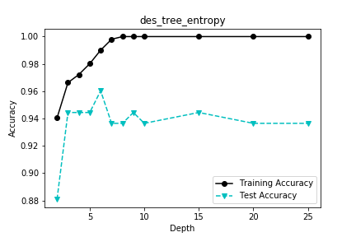
Data Mining Task
Classification on tumor class (Benign or Malignant)
Decision Tree with entropy as impurity measure.
10-fold cross validation

Slide 8
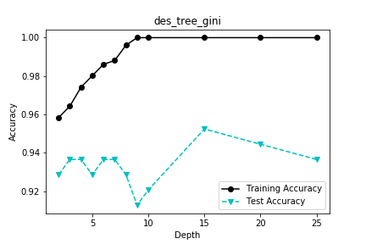
Data Mining Task
Classification on tumor class (Benign or Malignant)
Decision Tree with Gini index as impurity measure.
10-fold cross validation

Slide 9
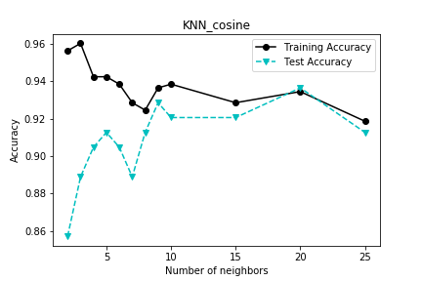
Data Mining Task
Classification on tumor class (Benign or Malignant)
K-Nearest Neighbor Classifier with Cosine distance.
10-fold cross validation

Slide 10
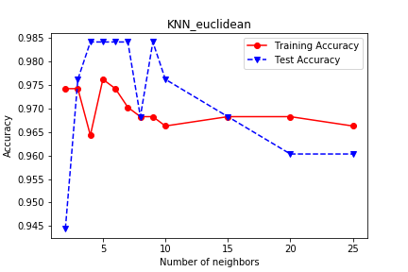
Data Mining Task
Classification on tumor class (Benign or Malignant)
K-Nearest Neighbor Classifier with Euclidean distance.
10-fold cross validation

Slide 11
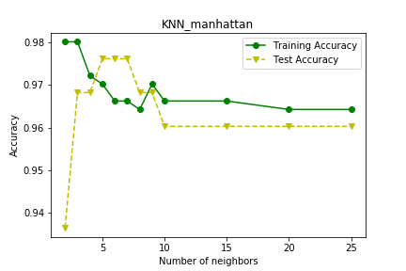
Data Mining Task
Classification on tumor class (Benign or Malignant)
K-Nearest Neighbor Classifier with Manhattan distance.
10-fold cross validation

Slide 12
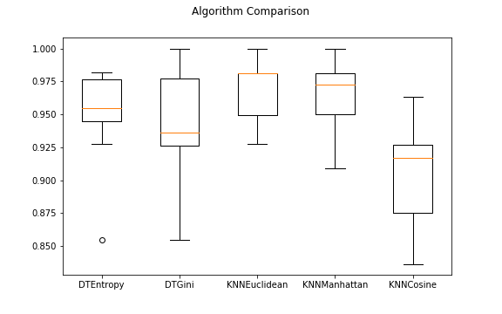
Results
Best case was K-Nearest Neighbor classifier with Euclidean Distance and ~5 neighbors

